Slide 1
Assessment of Multimodal Connectivity at Amtrak Cascades Stations
2019 Washington State Rail System Plan
TRBAPPCON 2019
June 5, 2019

Slide 2
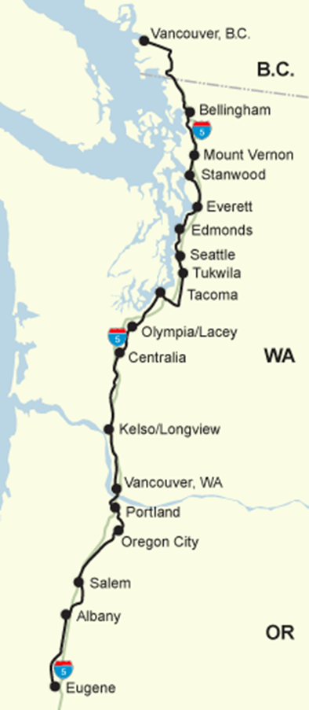
Background
Amtrak Cascades Corridor
Sponsored by the states of Washington and Oregon
Serves 18 stations from Vancouver, BC to Eugene, Oregon covering 467 miles
2019 Washington State Rail System Plan
Identify a preferred growth/performance scenario for Amtrak Cascades
Identify performance objectives for short-line freight rail system
Identify strategies to improve connections between rail and other modes

Slide 3
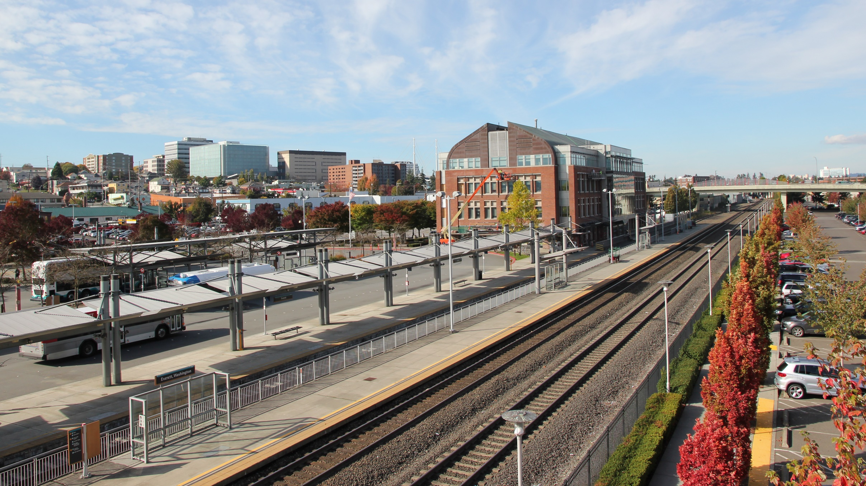
Why Study Station Connectivity?
Document travel options available for station access
Understand how riders use various travel options to get to and from stations
Identify ways WSDOT and partners can improve station connections to other modes

Slide 4
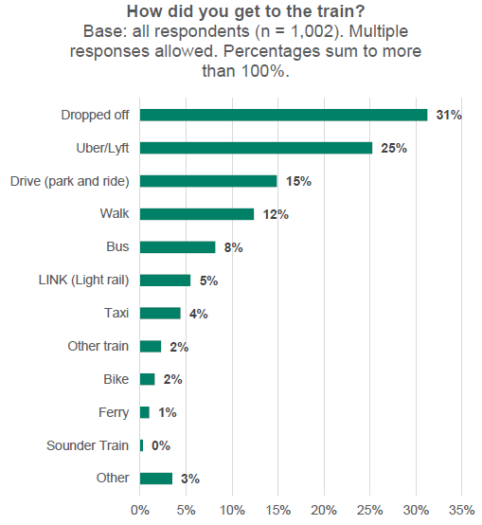
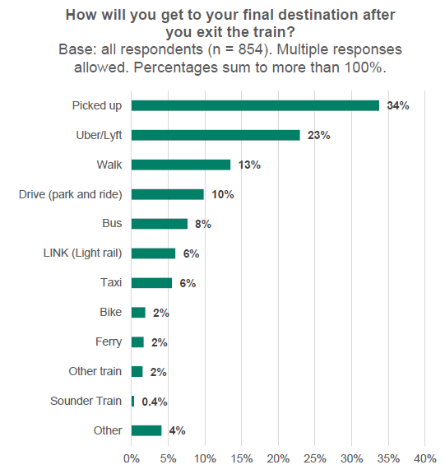
On-board Passenger Survey Findings

Slide 5
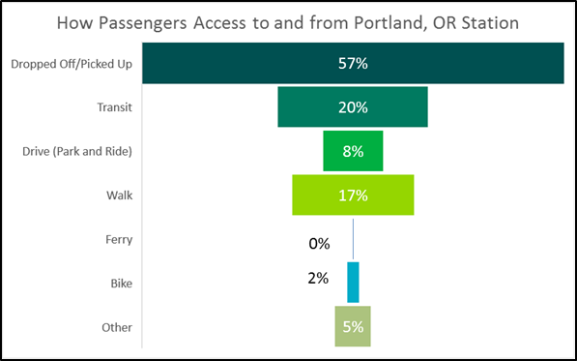
Portland Union Station Example
Union Station served 412,000 passengers in 2017
Survey results indicated that:
20% of riders access station by transit, and 17% by walk
51% of riders boarding at Portland were visiting friends, and 33% for sightseeing

Slide 6
Multimodal Connectivity Analysis Framework
Connectivity evaluation Criteria and measures
Land Use
Mobility
Connected Transportation System
Data sources
Federal, state, and local data sources
Field assessment
Categories & Measures | Measures | Maximum Points | Maximum Score
LAND USE | 2 | 6 | 2
Station Location Context & Attractors |  | 3
Zero Car Household |  | 3
MOBILITY | 3 | 9 | 3
Transit Service |  | 3
Private Transportation Connection Options |  | 3
Human Services Transportation |  | 3
CONNECTED TRANSPORTATION NETWORK | 5 | 15 | 5
At-Grade Railroad Crossings |  | 3
Sidewalks |  | 3
Bicycle Facilities |  | 3
Drop-off/Pick-up Areas |  | 3
Wayfinding |  | 3
Station Connectivity-Total | 10 | 30 | 10

Slide 7
Station Connectivity Scoring Comparison – Preliminary Results

Slide 8
Portland Union Station Connectivity Analysis
Table 1. Connectivity Evaluation: Portland
Categories & Measures | Measures | Maximum Points | Maximum Score | Points | Score
LAND USE | 2 | 6 | 2 | 6 | 2.0
Station Location Context & Attractors |  | 3 |  | 3
Zero Car Household |  | 3 |  | 3
MOBILITY | 3 | 9 | 3 | 7 | 2.3
Transit Service |  | 3 |  | 2
Private Transportation Connection Options |  | 3 |  | 3
Human Services Transportation |  | 3 |  | 2
CONNECTED TRANSPORTATION NETWORK | 5 | 15 | 5 | 13 | 4.3
At-Grade Railroad Crossings |  | 3 |  | 3
Sidewalks |  | 3 |  | 3
Bicycle Facilities |  | 3 |  | 3
Drop-off/Pick-up Areas |  | 3 |  | 2
Wayfinding |  | 3 |  | 2
Station Connectivity-Total | 10 | 30 | 10 | 26 | 8.7

Slide 9
Portland Union Station Connectivity Analysis

Slide 10
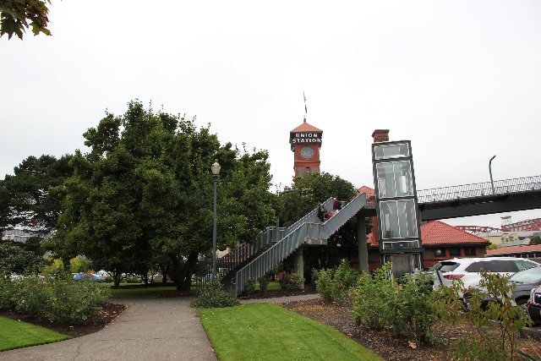
Candidate Station Access Improvements
Identify station connectivity gaps and opportunities for improvements
Portland Union Station examples:
Type | Gaps | Candidate Improvement* | Potential Project Examples/Locations*
Multimodal | Designated drop-off/pick-up area | Signage, striping, and additional designated drop-off/pick-up area for accessible/disabled transportation, either on-site or on-street at station areas | Improve signage and markings at station frontage
Multimodal | Wayfinding signs | Install additional wayfinding signs in station area | Locations to be determined
Pedestrian | Complete sidewalks (curb, gutter, ramps) | Sidewalk improvements, lighting, and other pedestrian amenities within 1/4-mile radius of stations | Sidewalk ramp upgrades to current accessibility guidelines

Slide 11
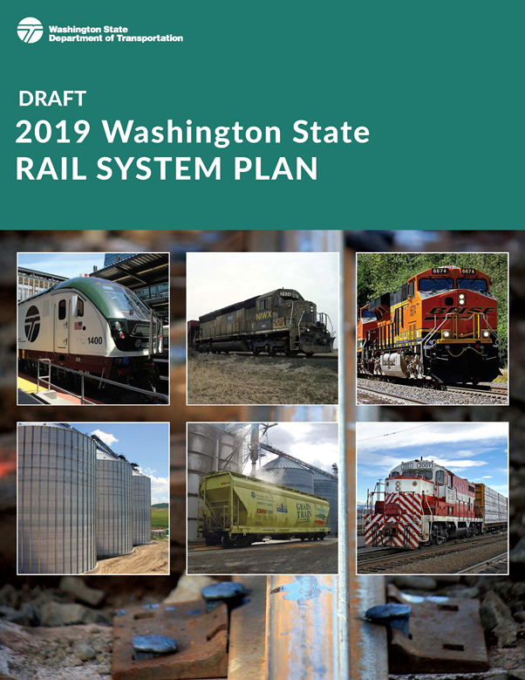
Next Steps
Stay engaged with stakeholders through plan development and review process
Finalize and publish State Rail System Plan by winter 2019

Slide 12
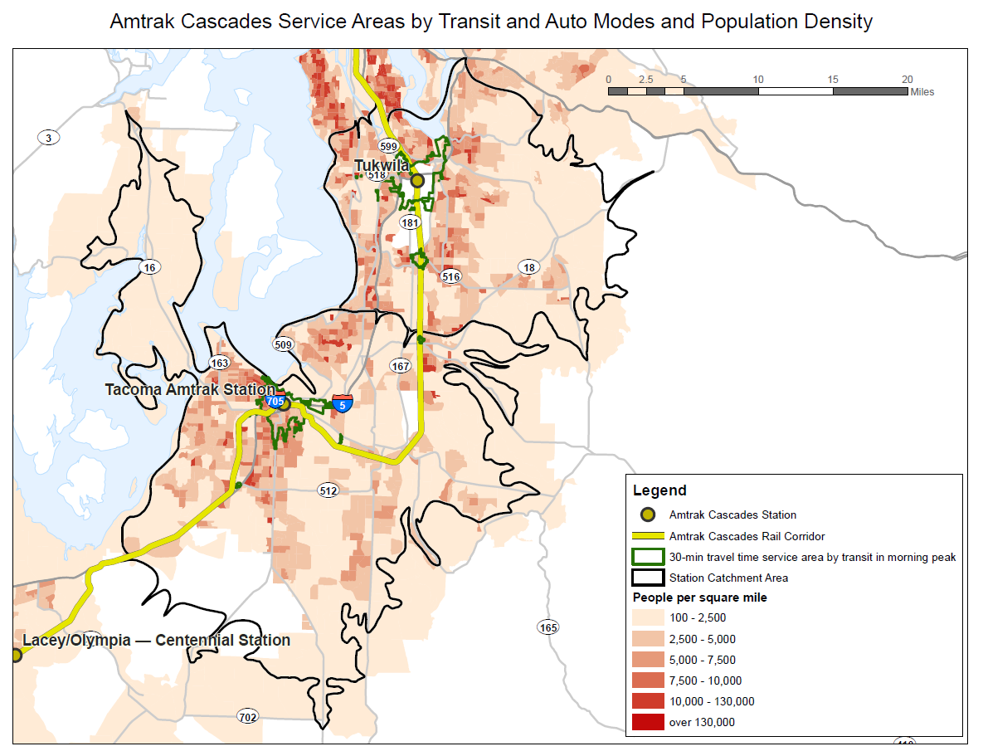
Next Steps
Evaluate the viability of implementing identified improvements
Integrate connectivity analysis into decision-making
Continue to look for ways to better evaluate station connectivity

Slide 13
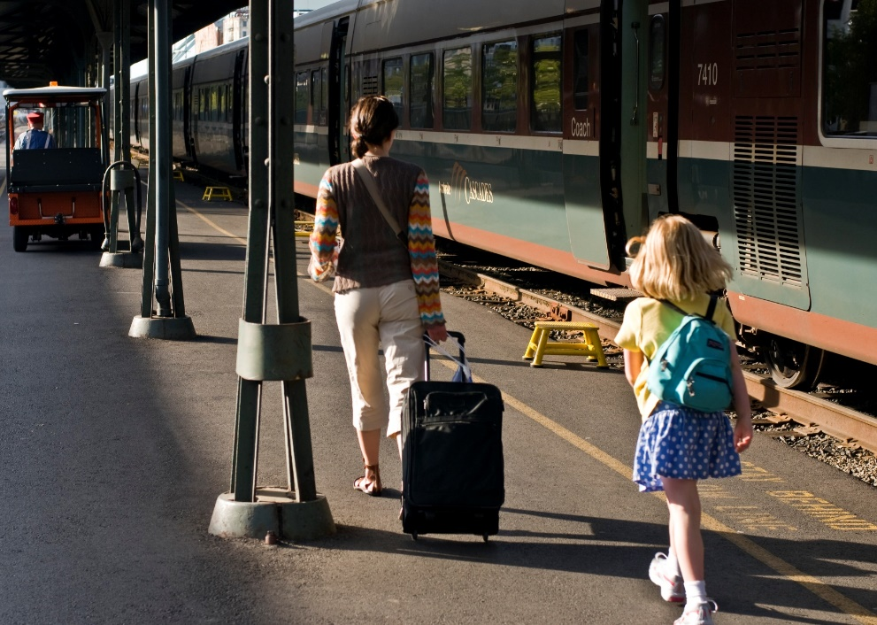
Thank You
For more information:
http://www.wsdot.wa.gov/Rail/staterailplan.htm
Paul Krueger
KruegeP@wsdot.wa.gov

